Slide 1
Inside-out vision-based hand tracking performance

Slide 2
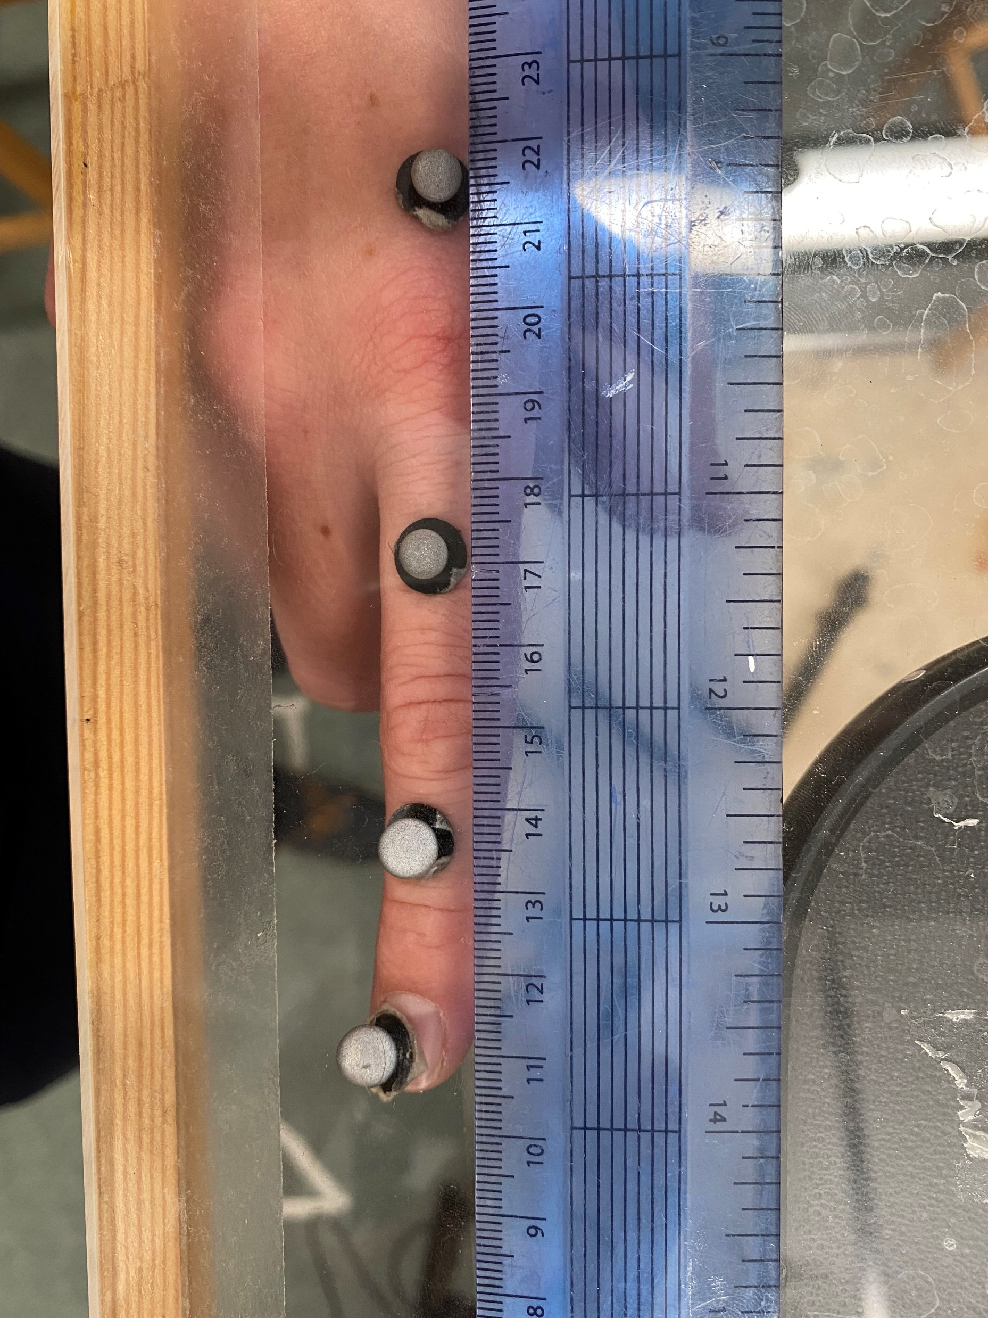
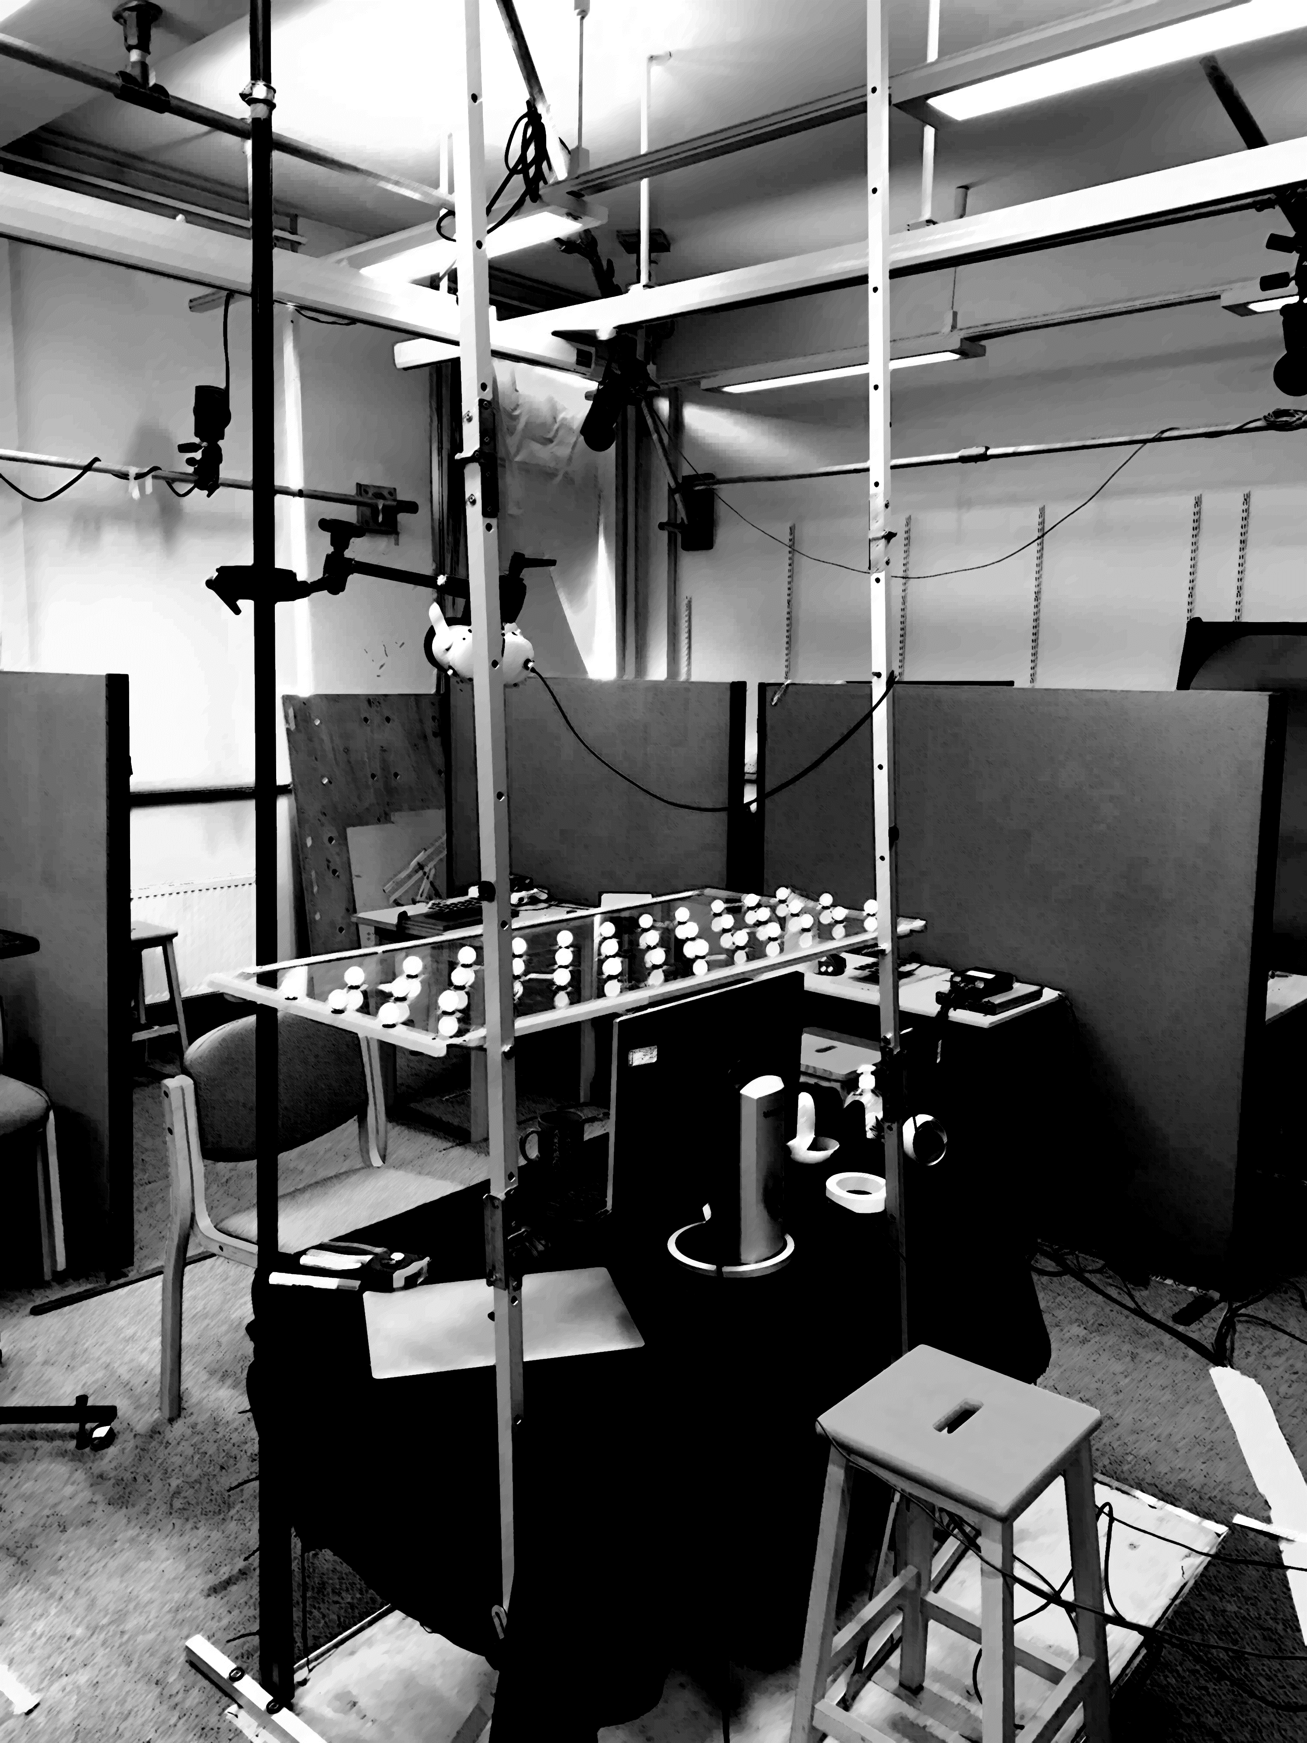
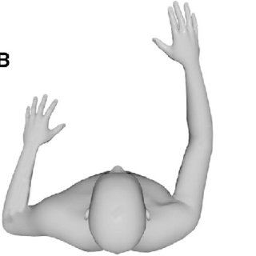

Experimental setup using marker-based ground-truth mocap
and Oculus Quest HMD for hand and finger tracking
MoCap Camera
120 cm
IR Reflective Marker
20 cm
3 heights
HMD

Slide 3
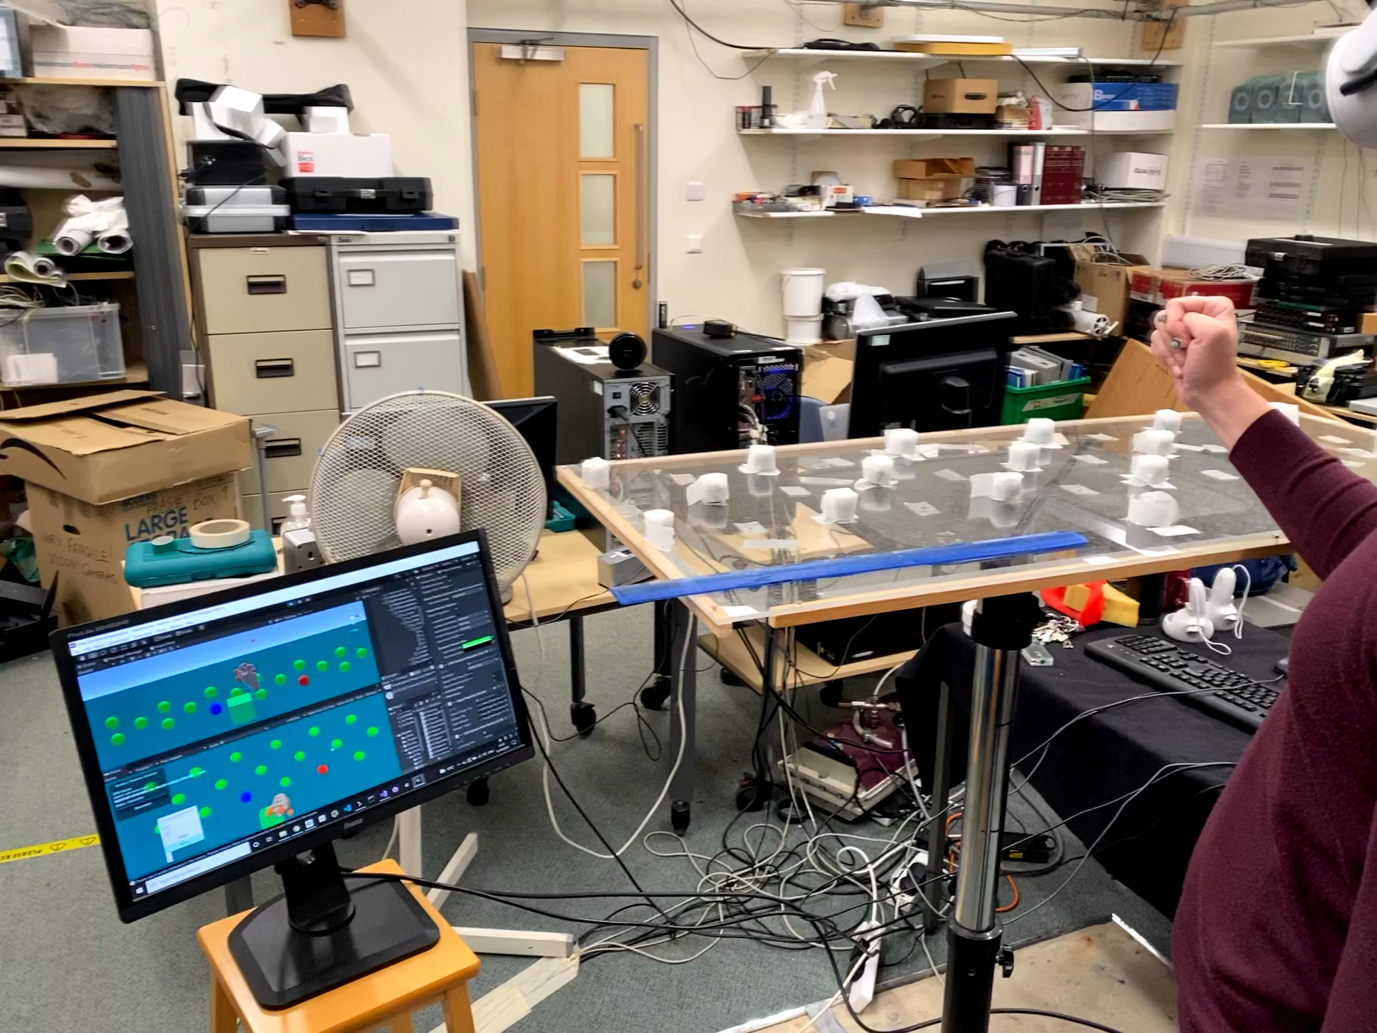
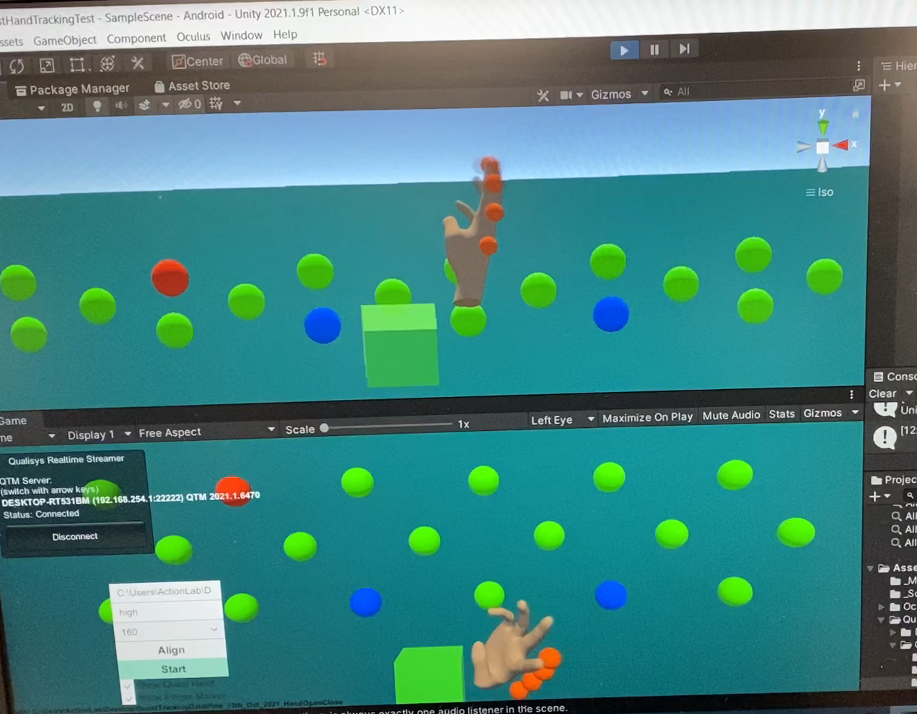
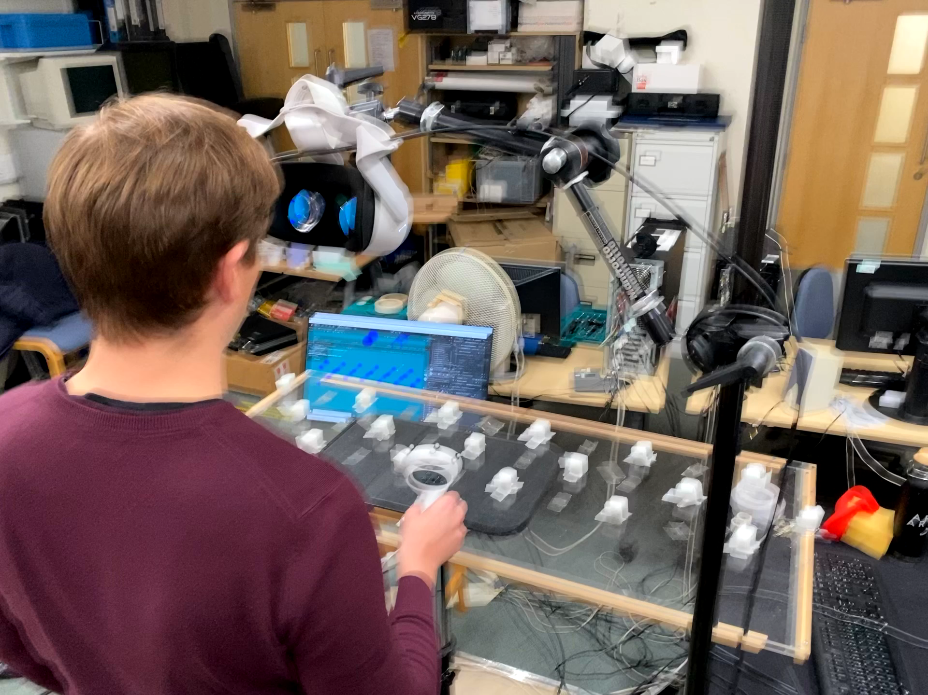

Slide 4
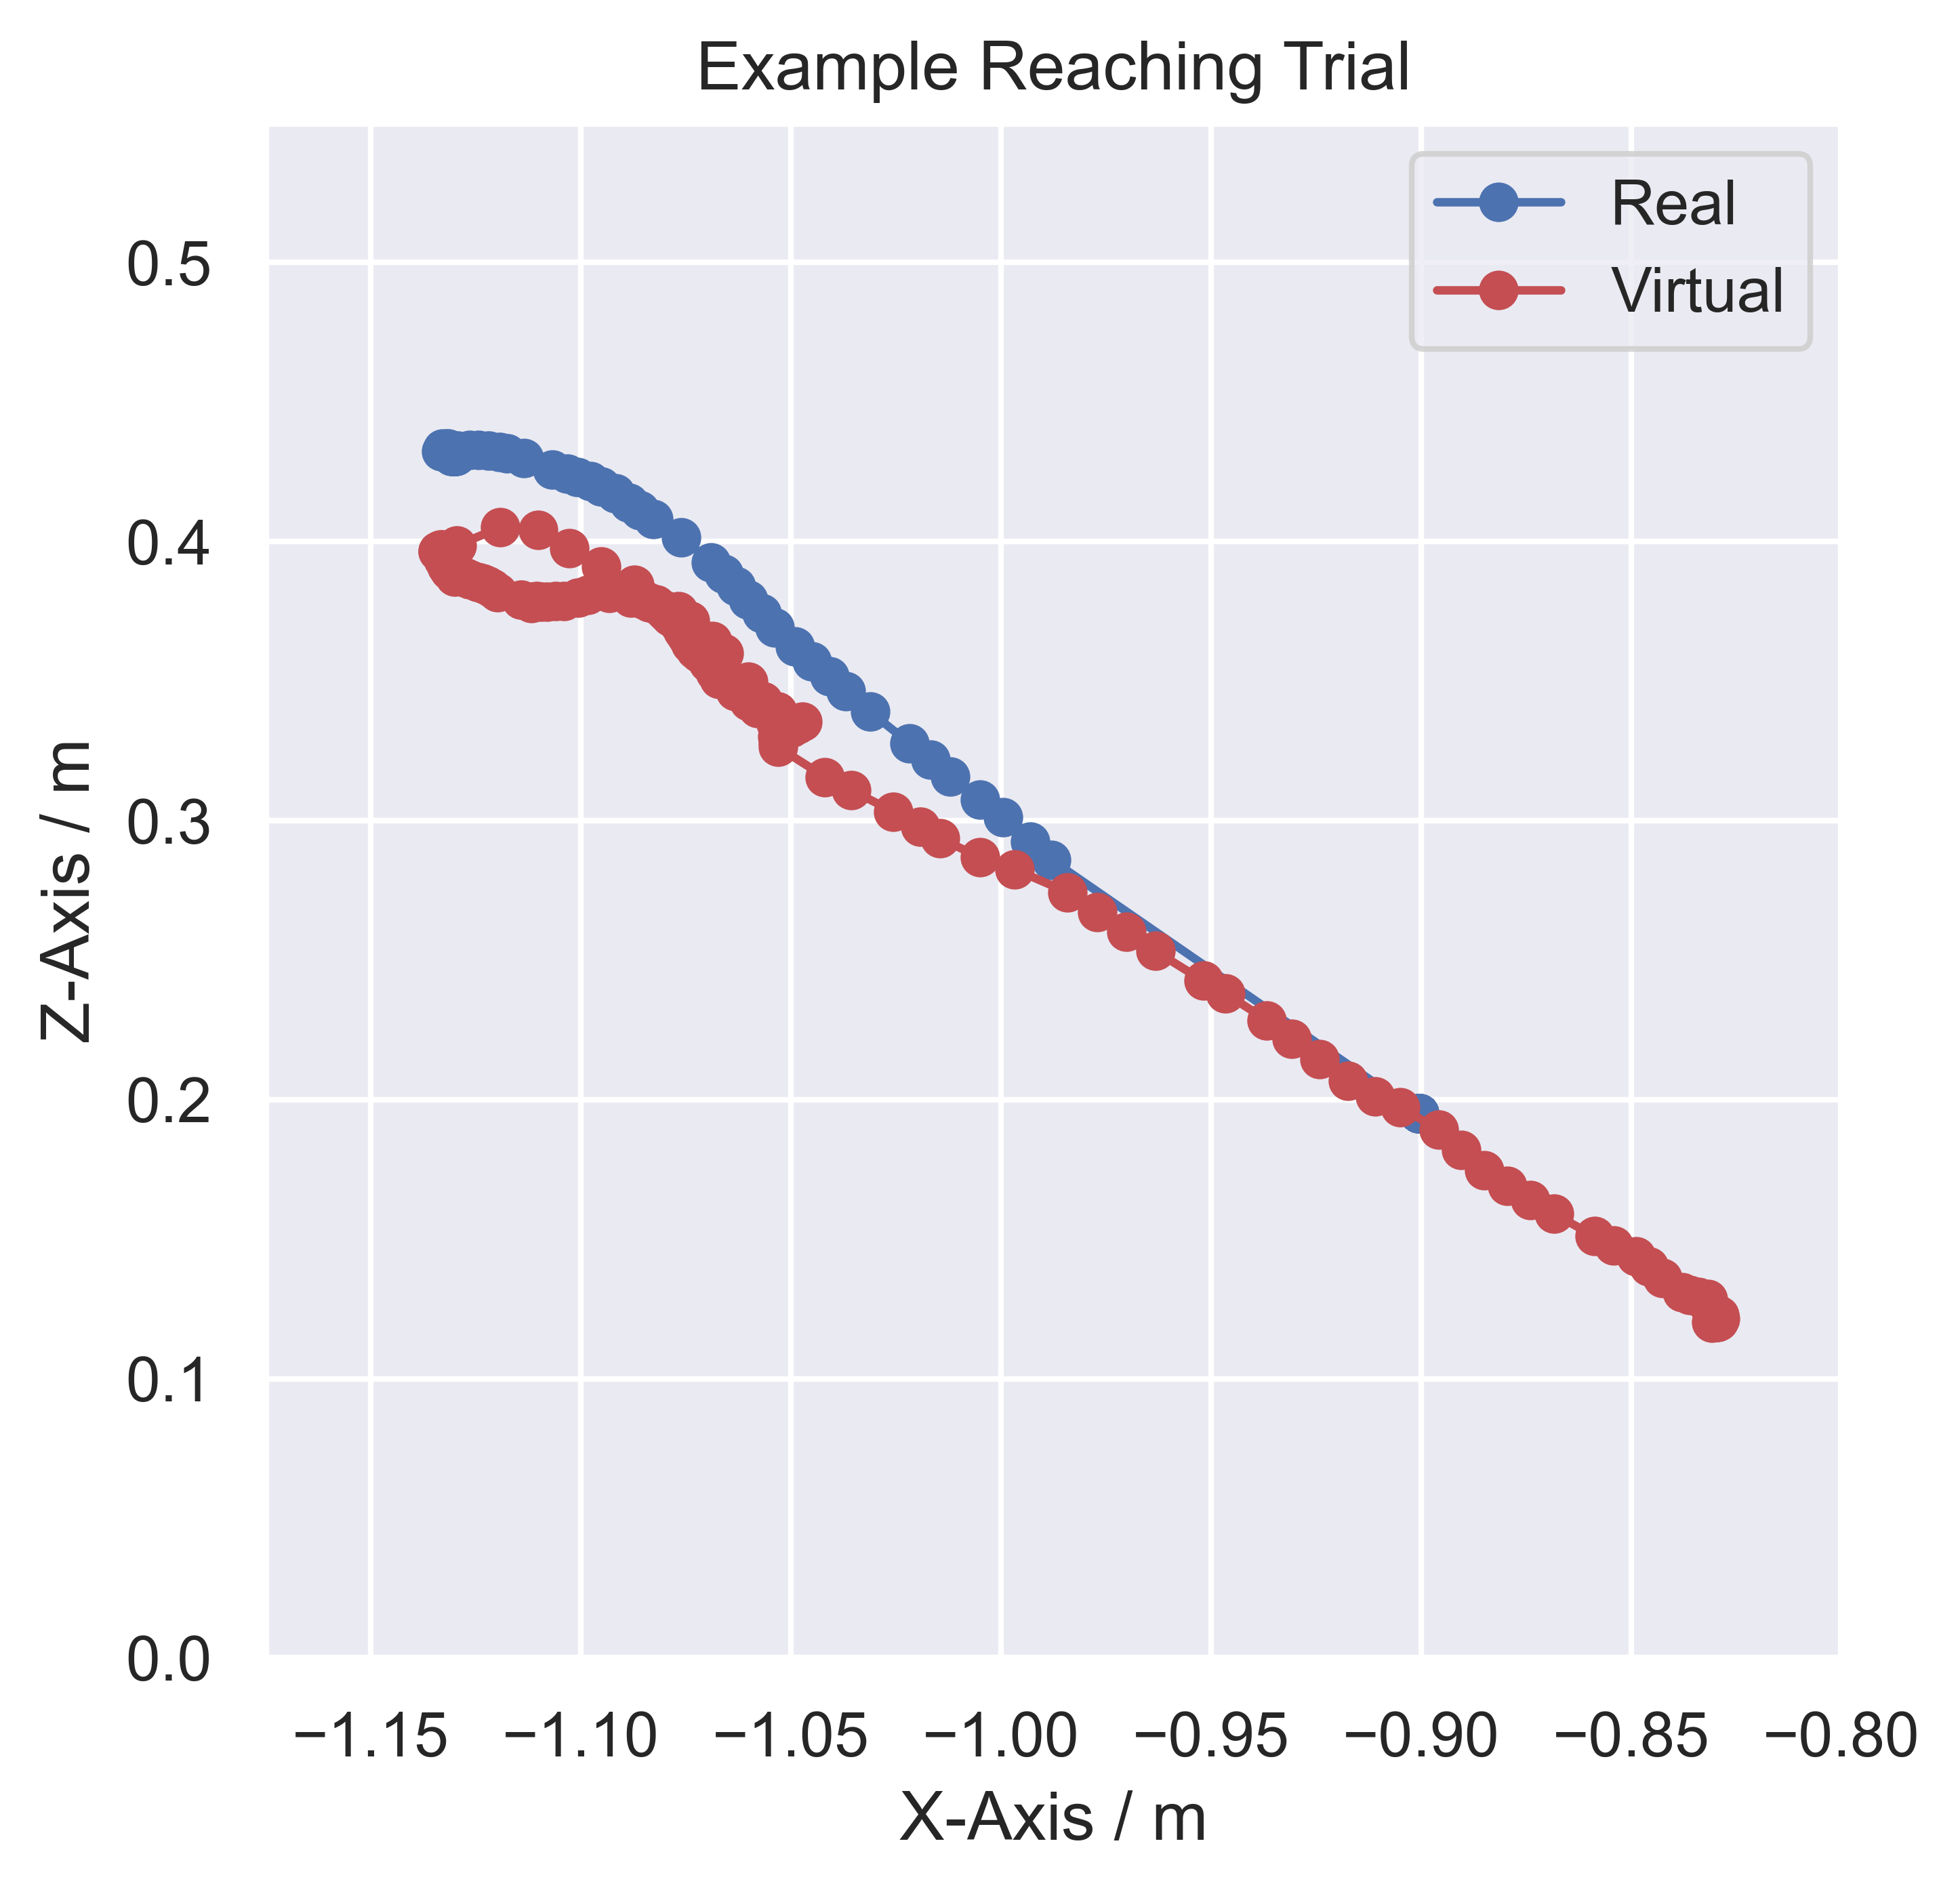
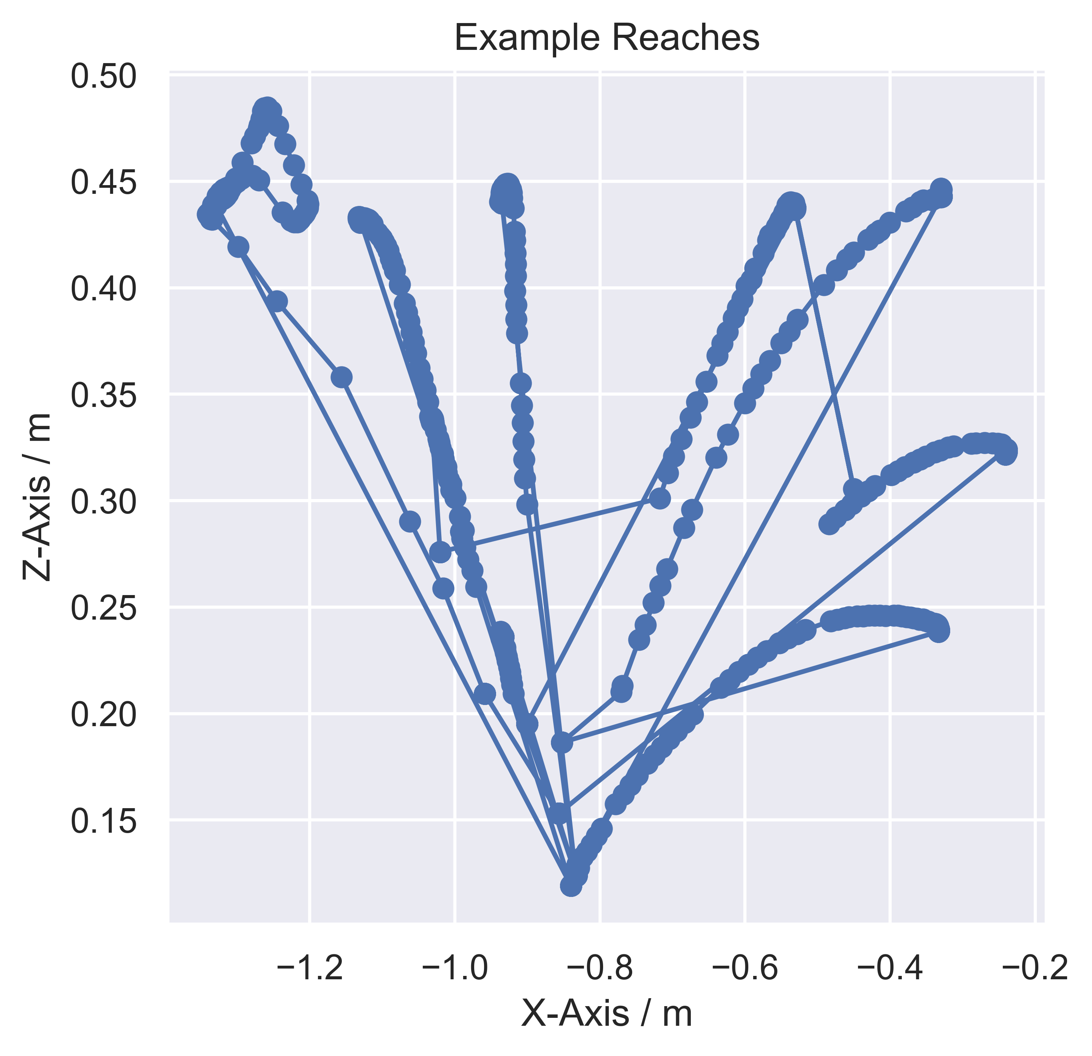
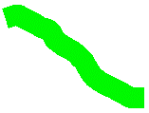
Example virtual and real fingertip reaching trials
End-point
error
Cumulative
path
error
E
E
E
E
E
E
E
S
S

Slide 5
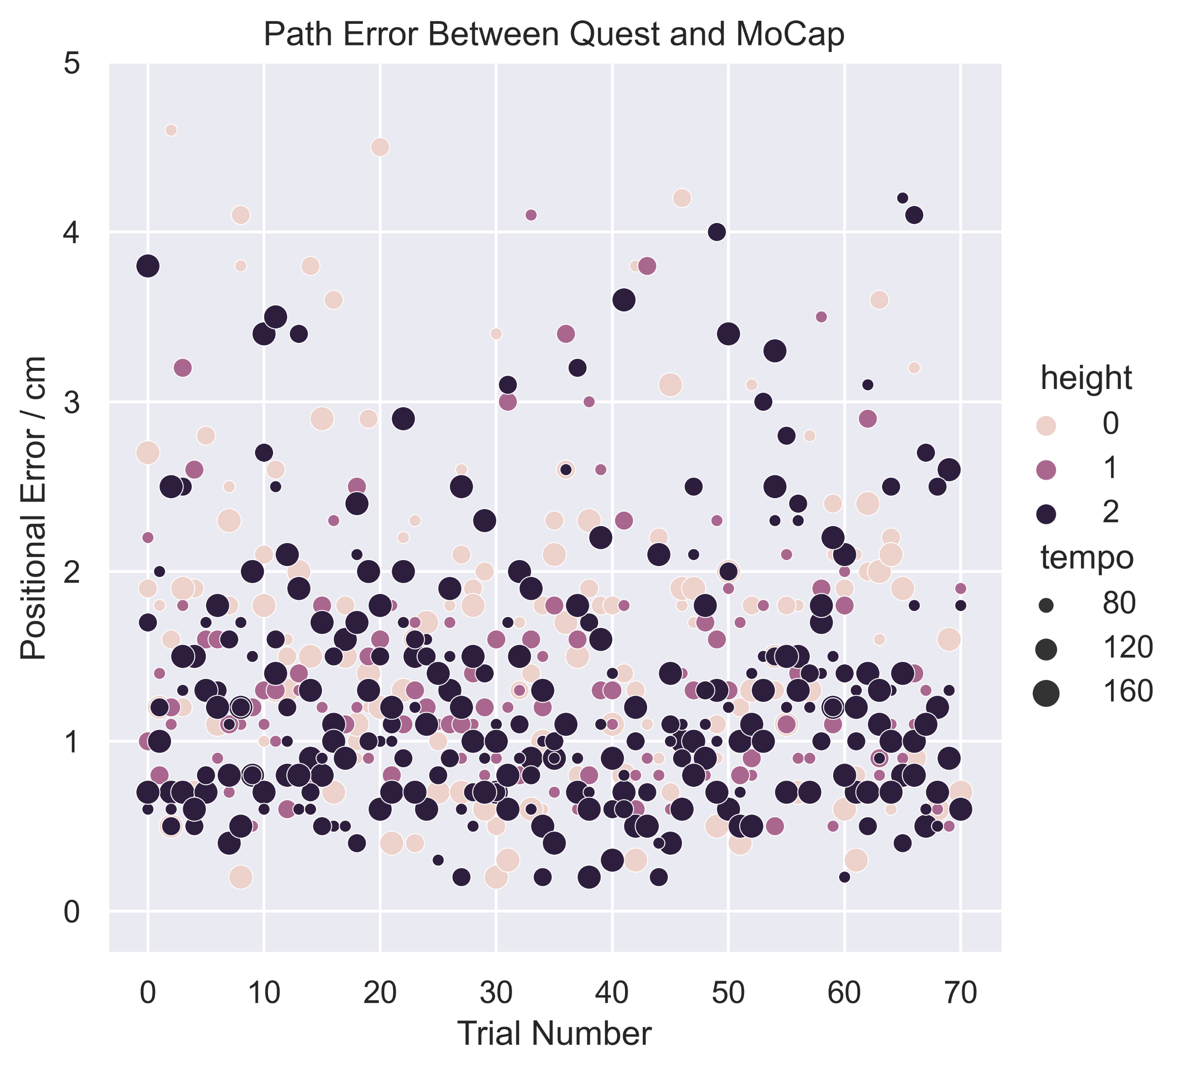
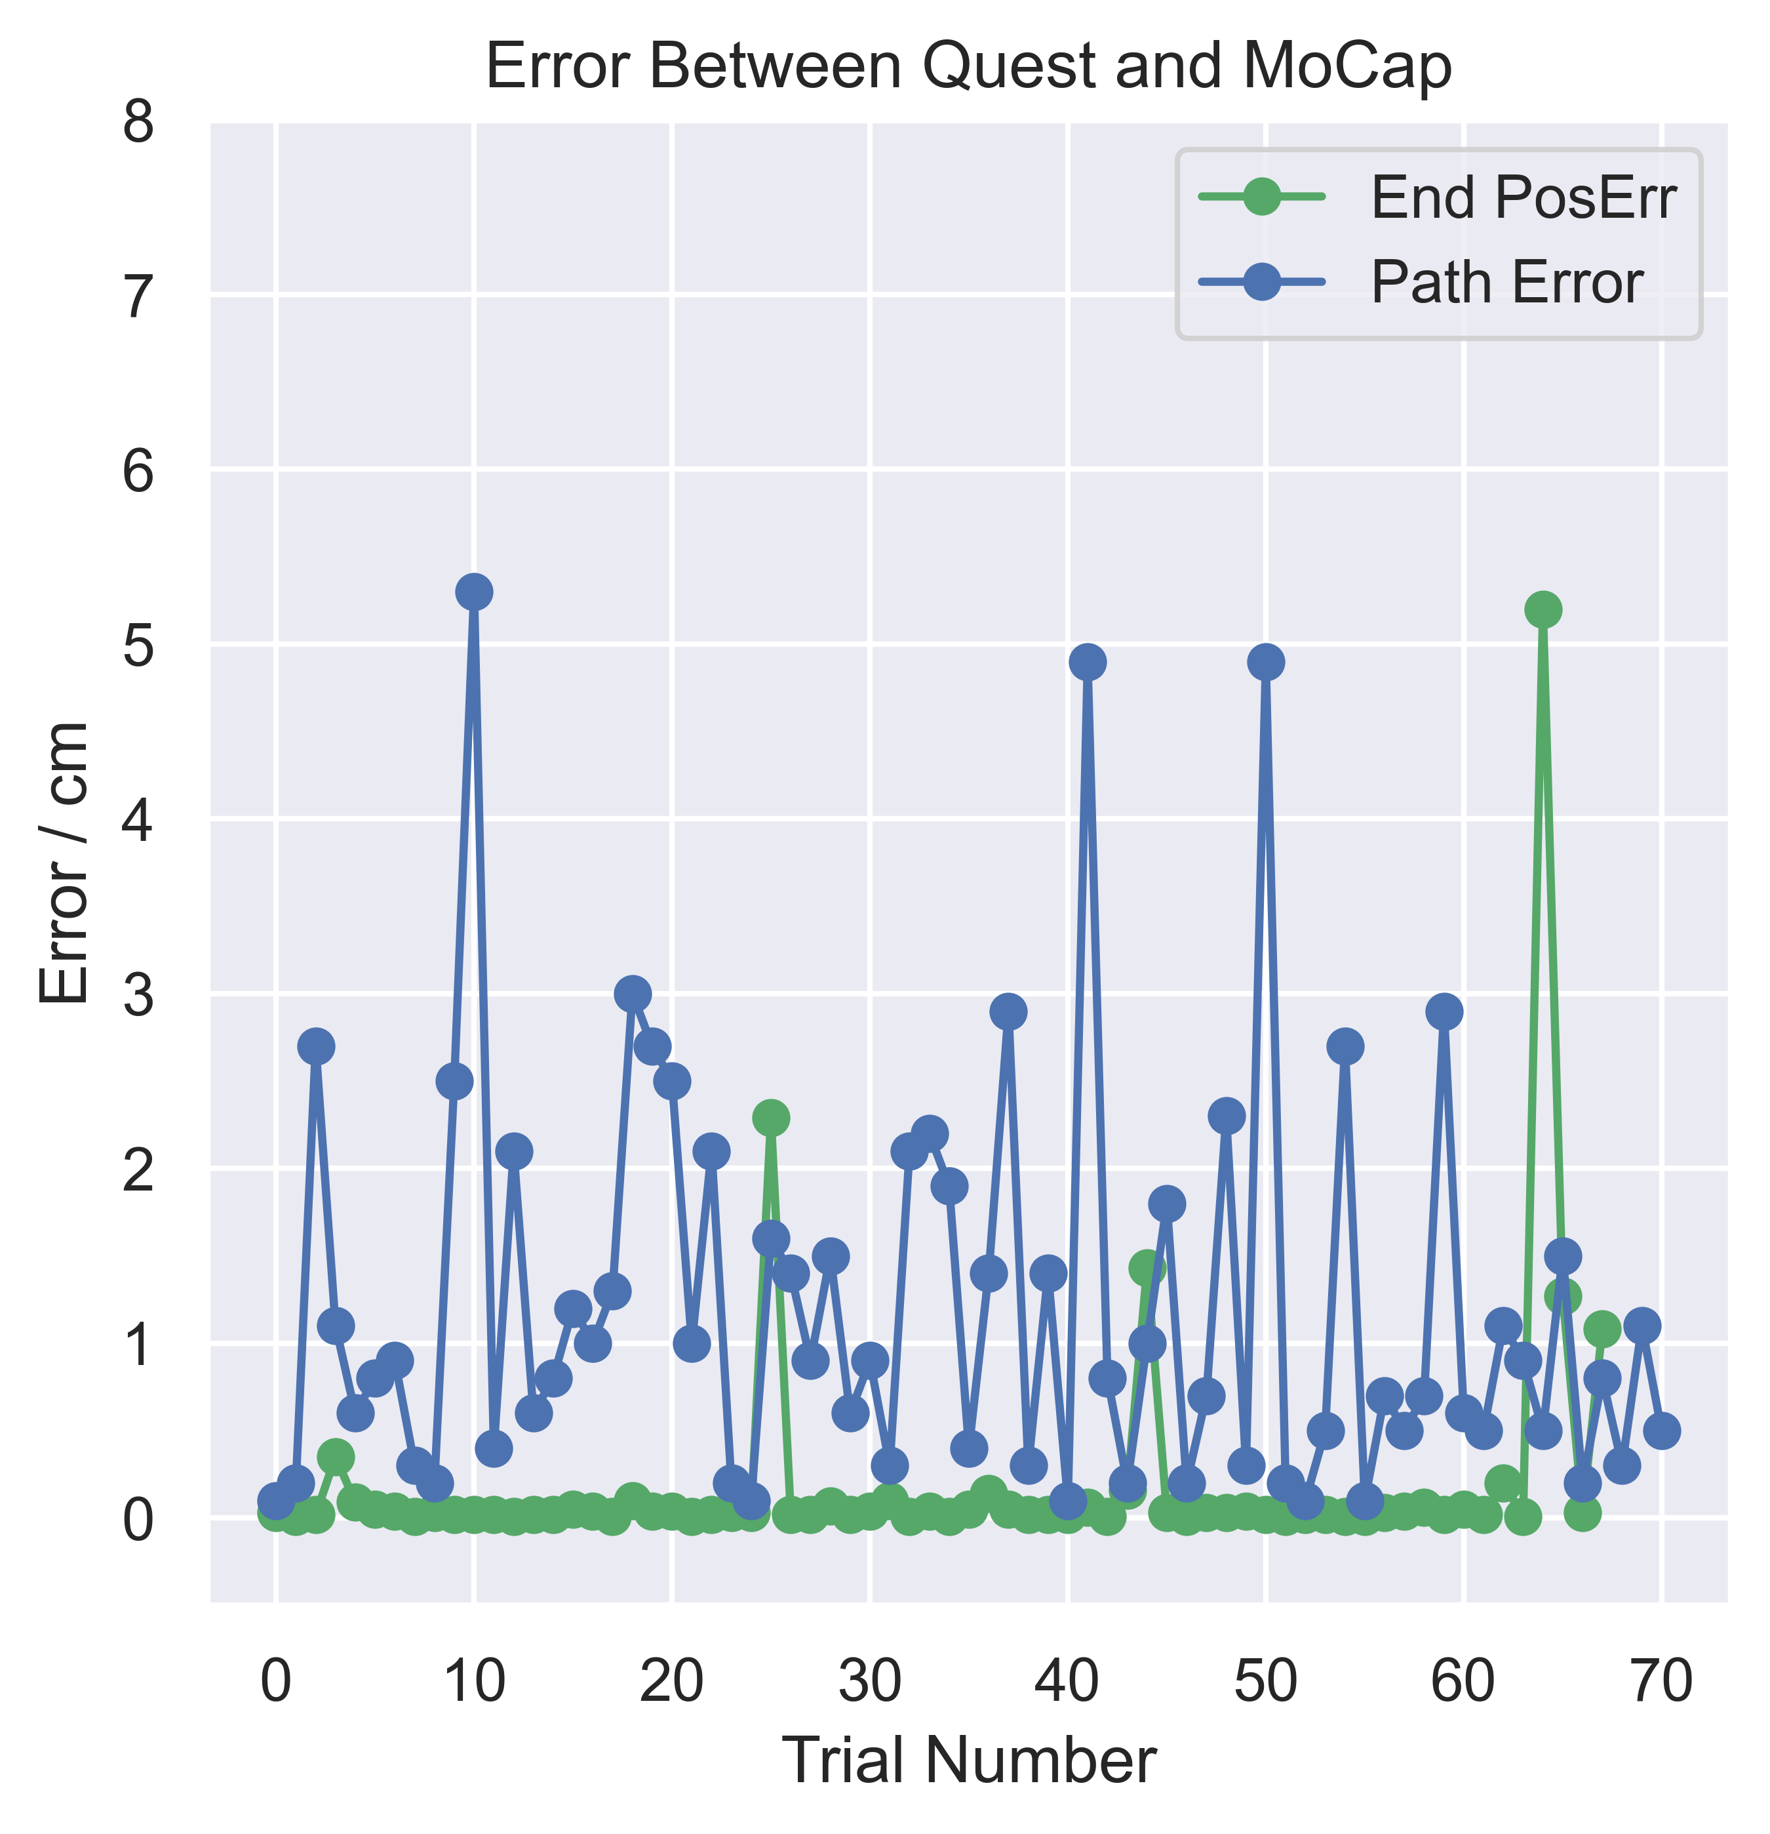
Participant average end-point and cumulative path errors across trials

Slide 6
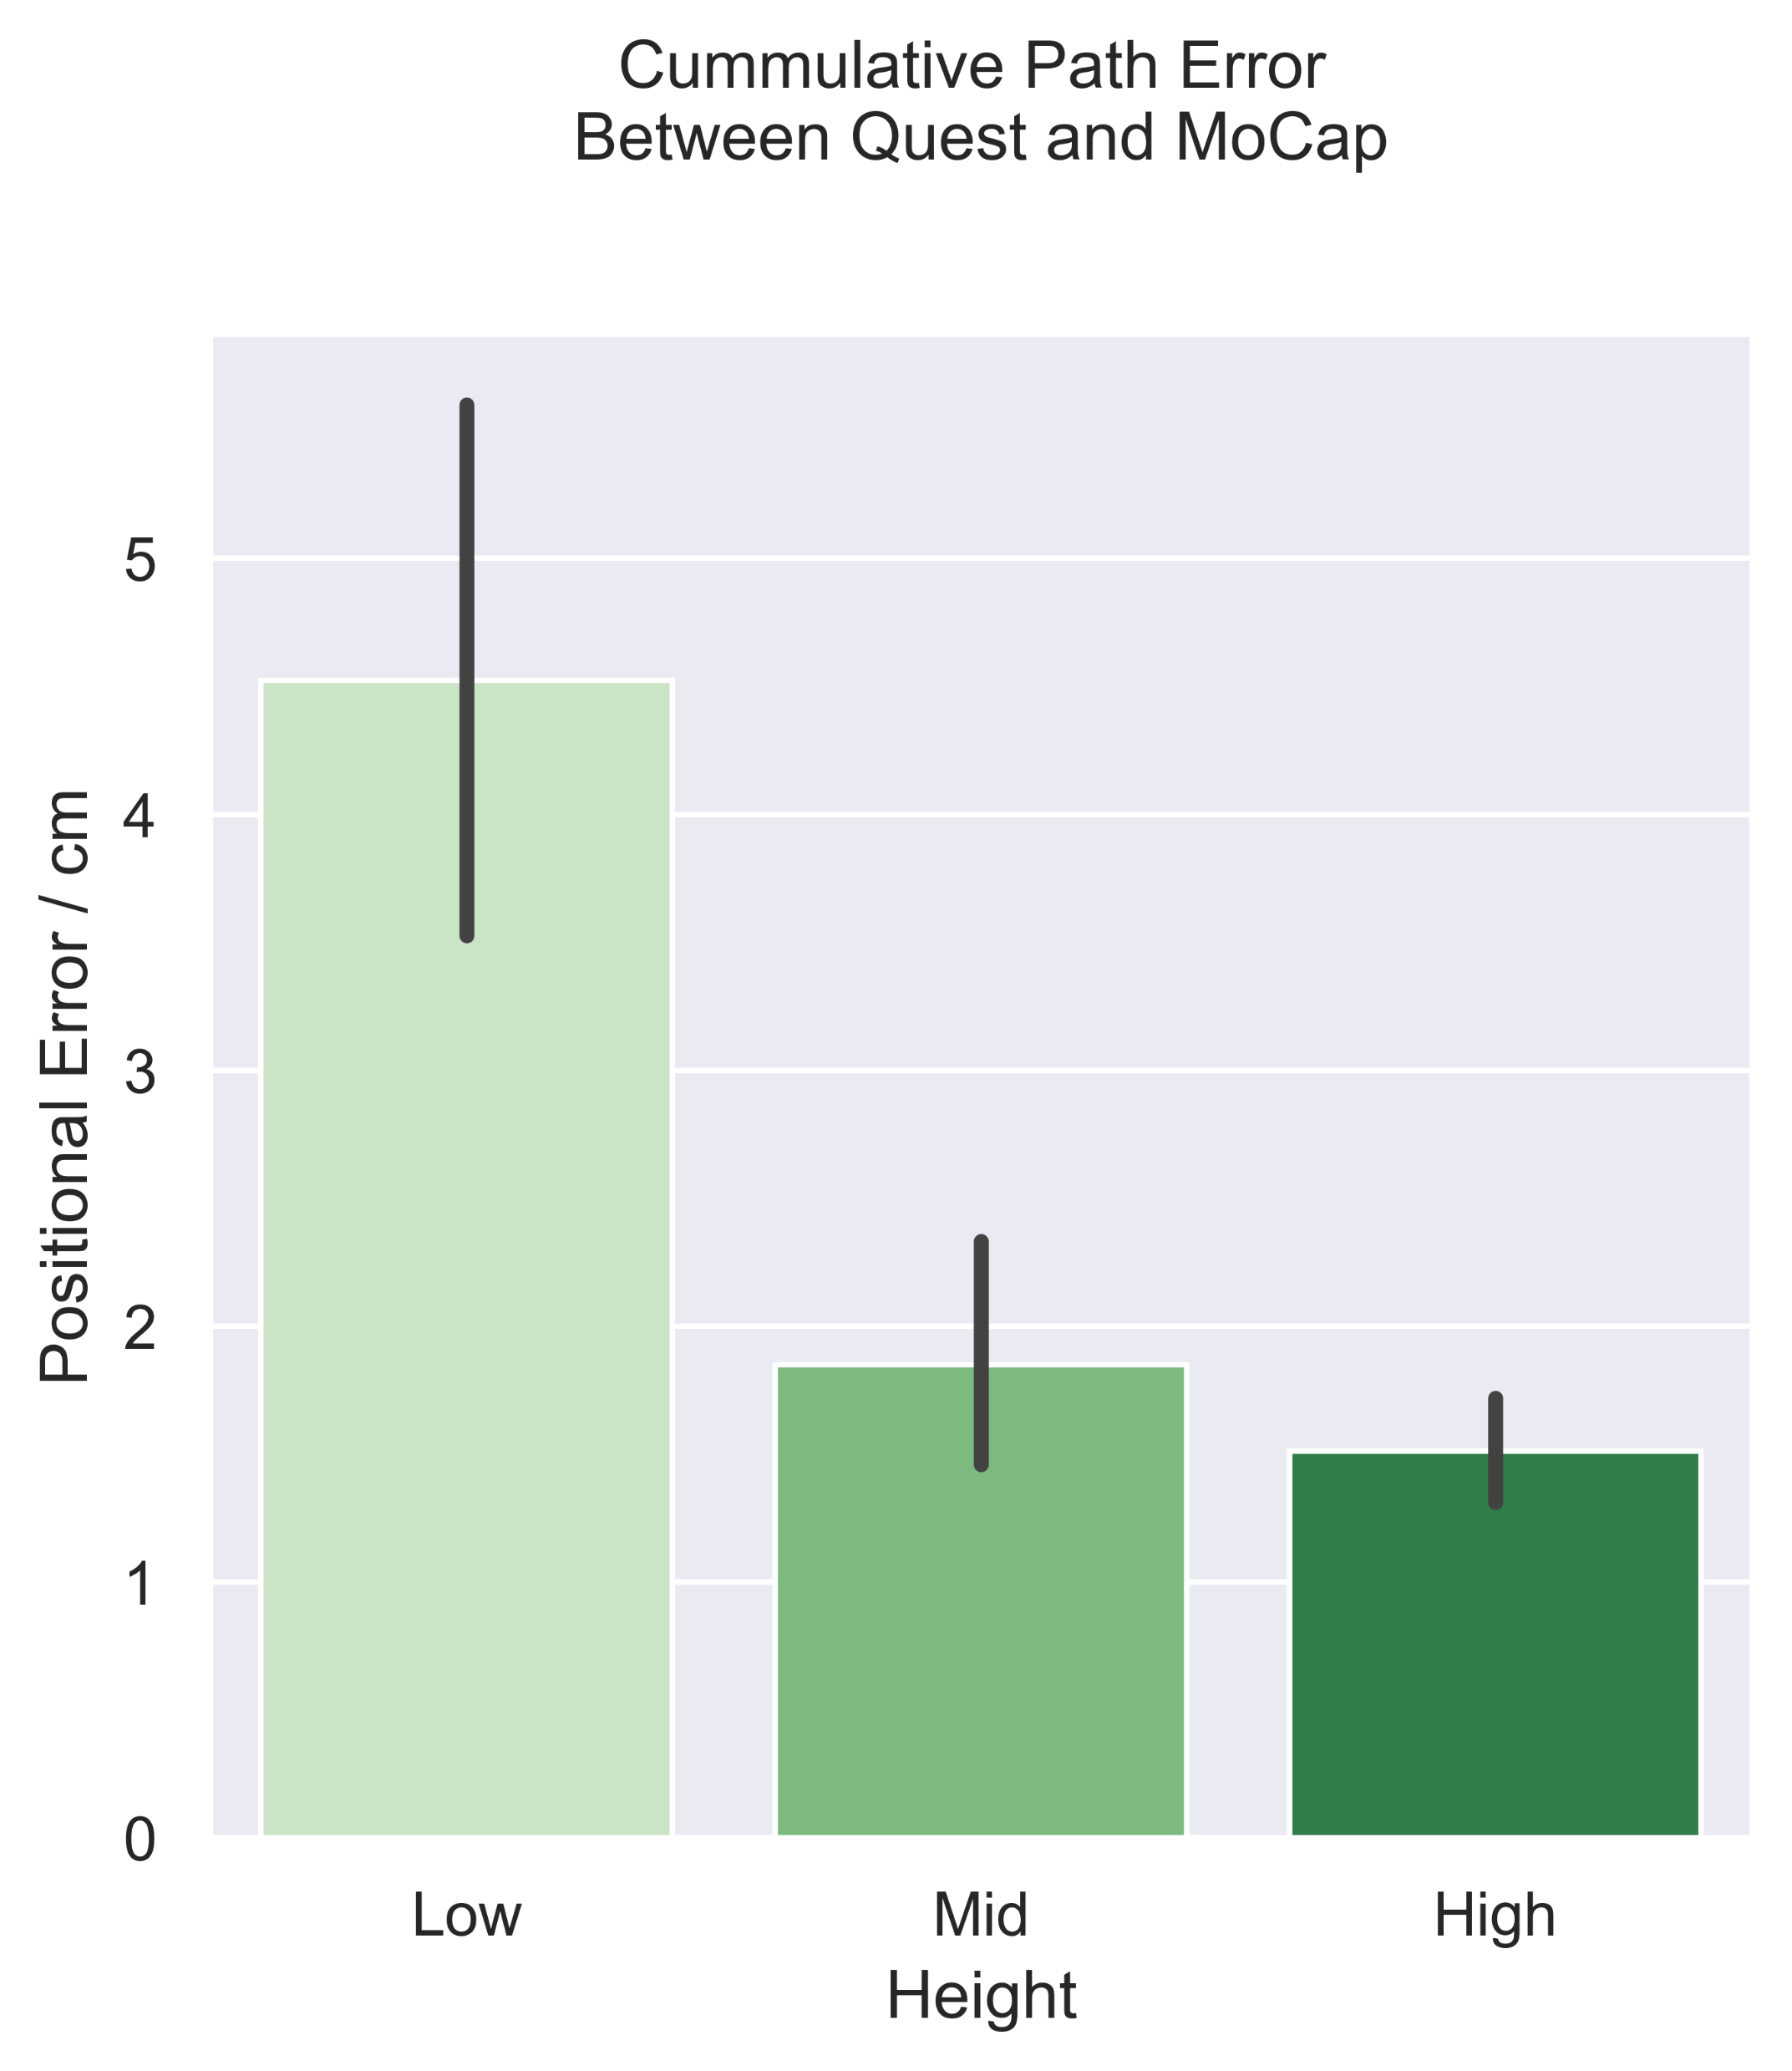
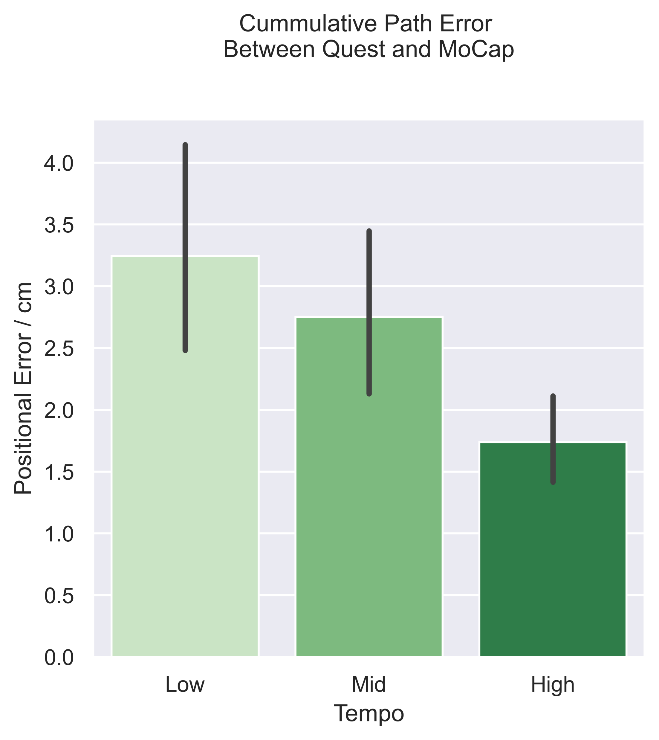
Average errors between virtual and real fingertip positions

Slide 7
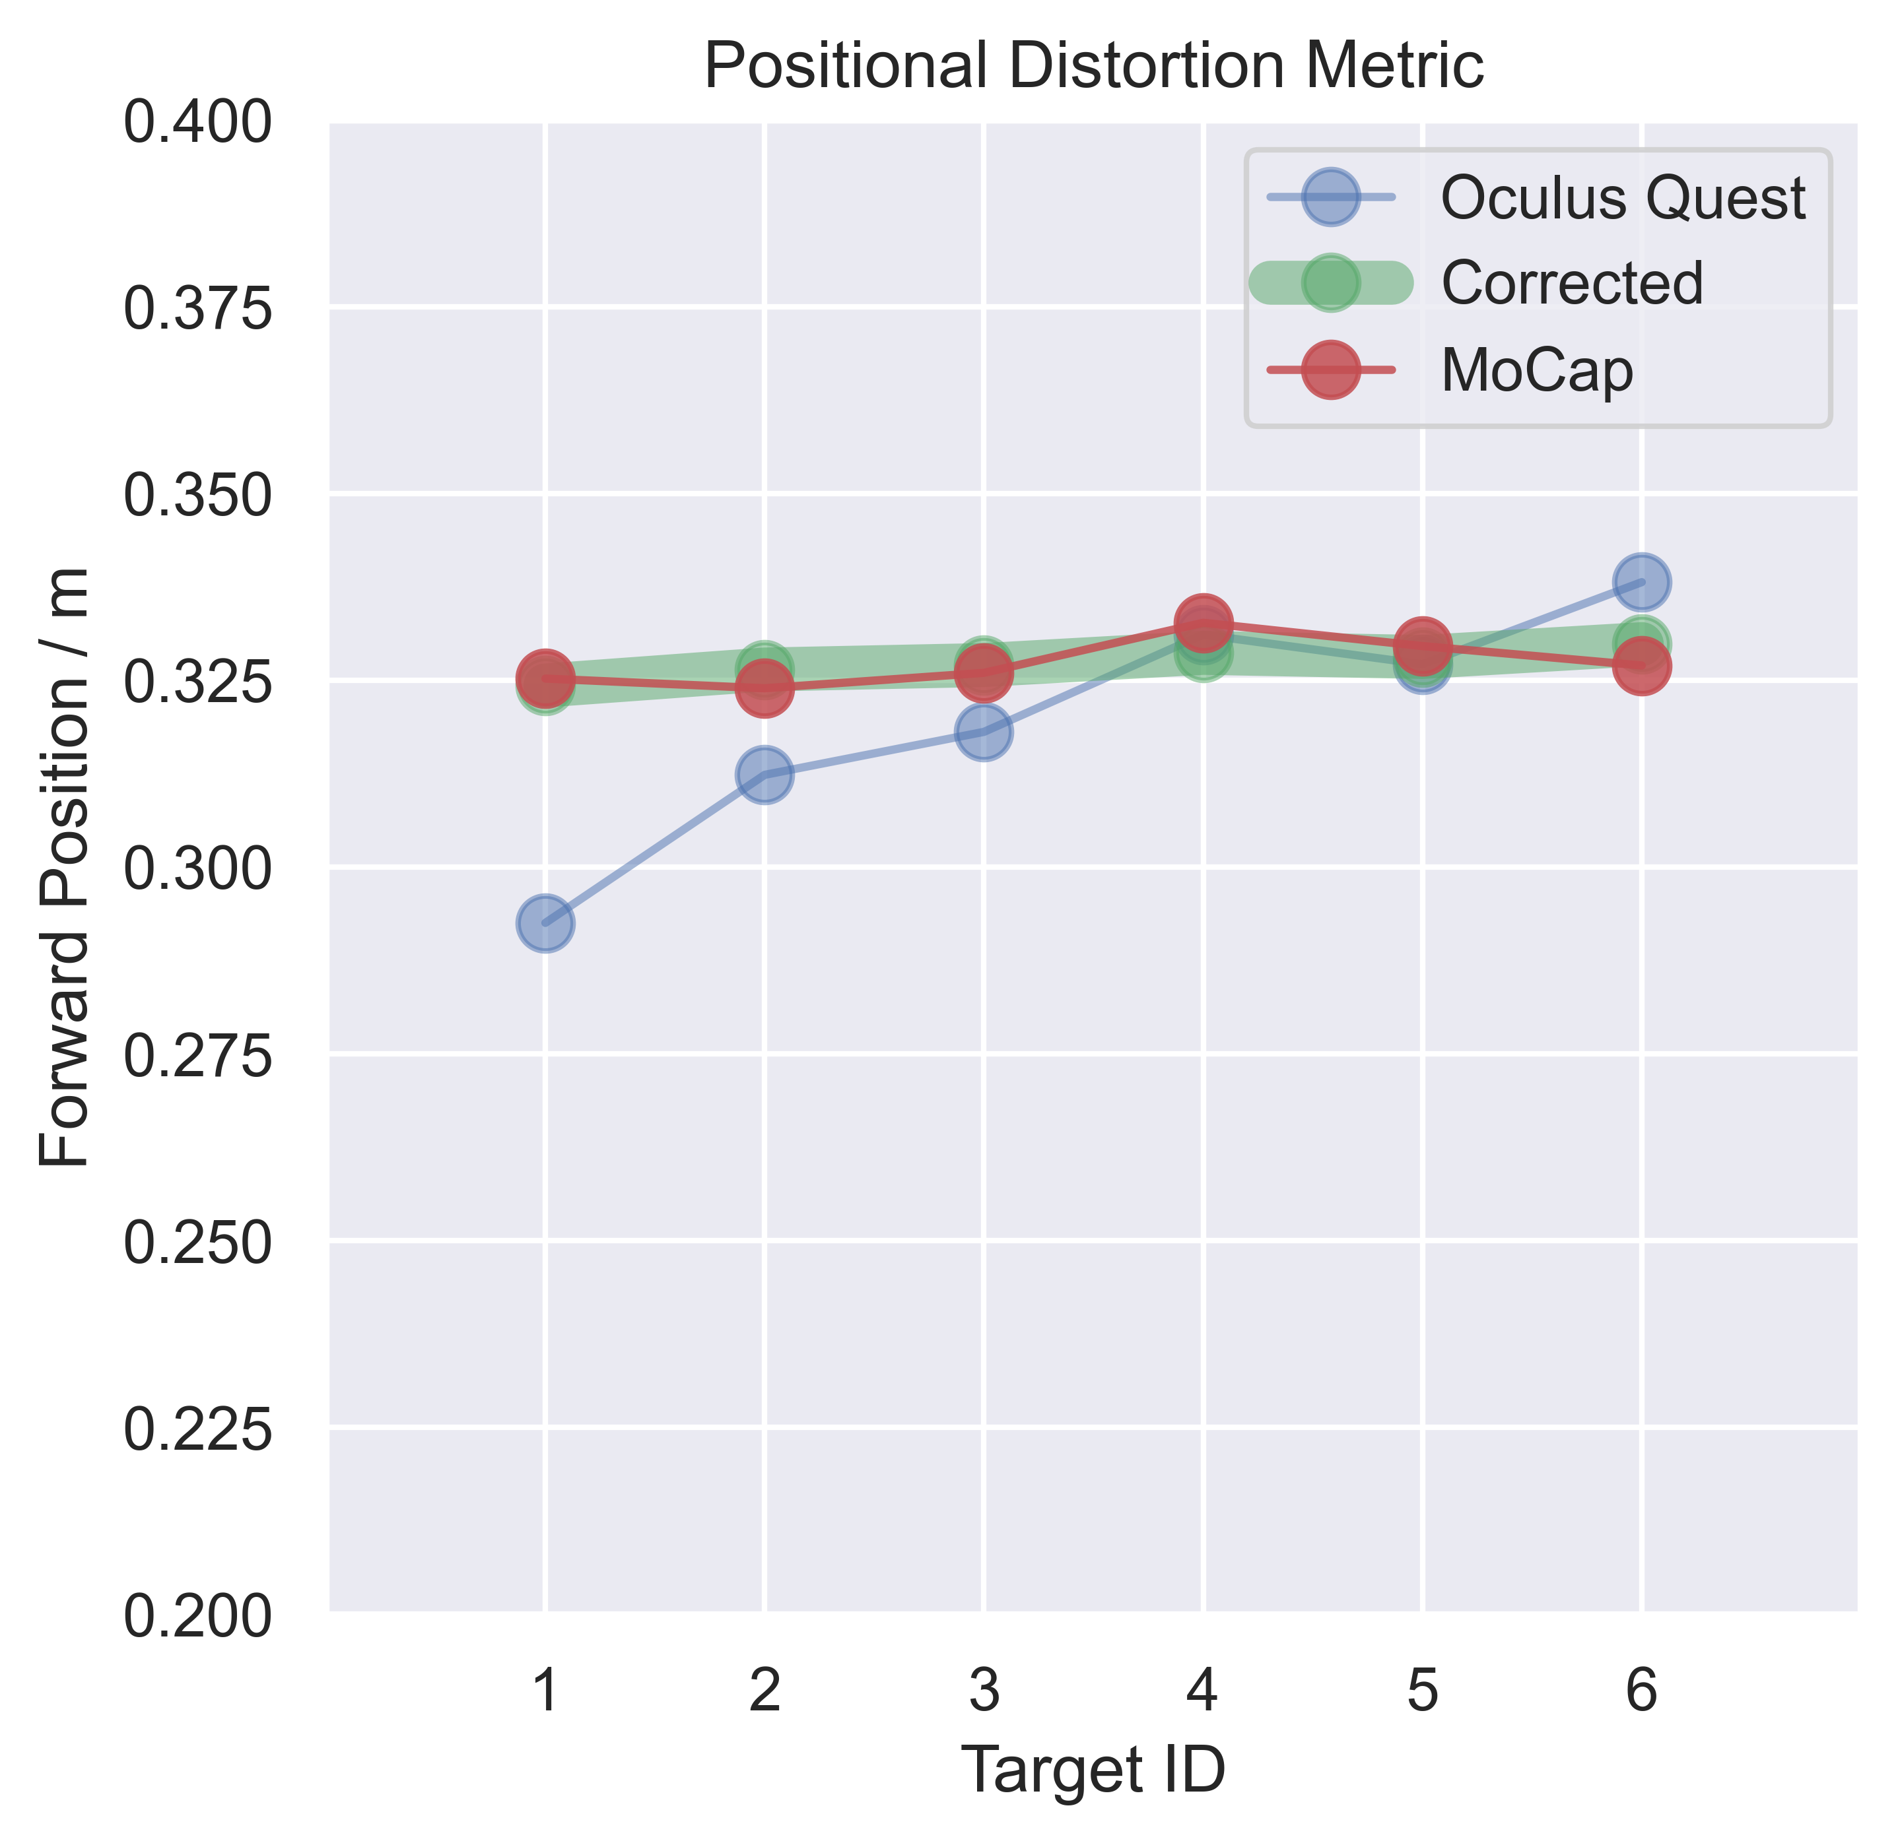
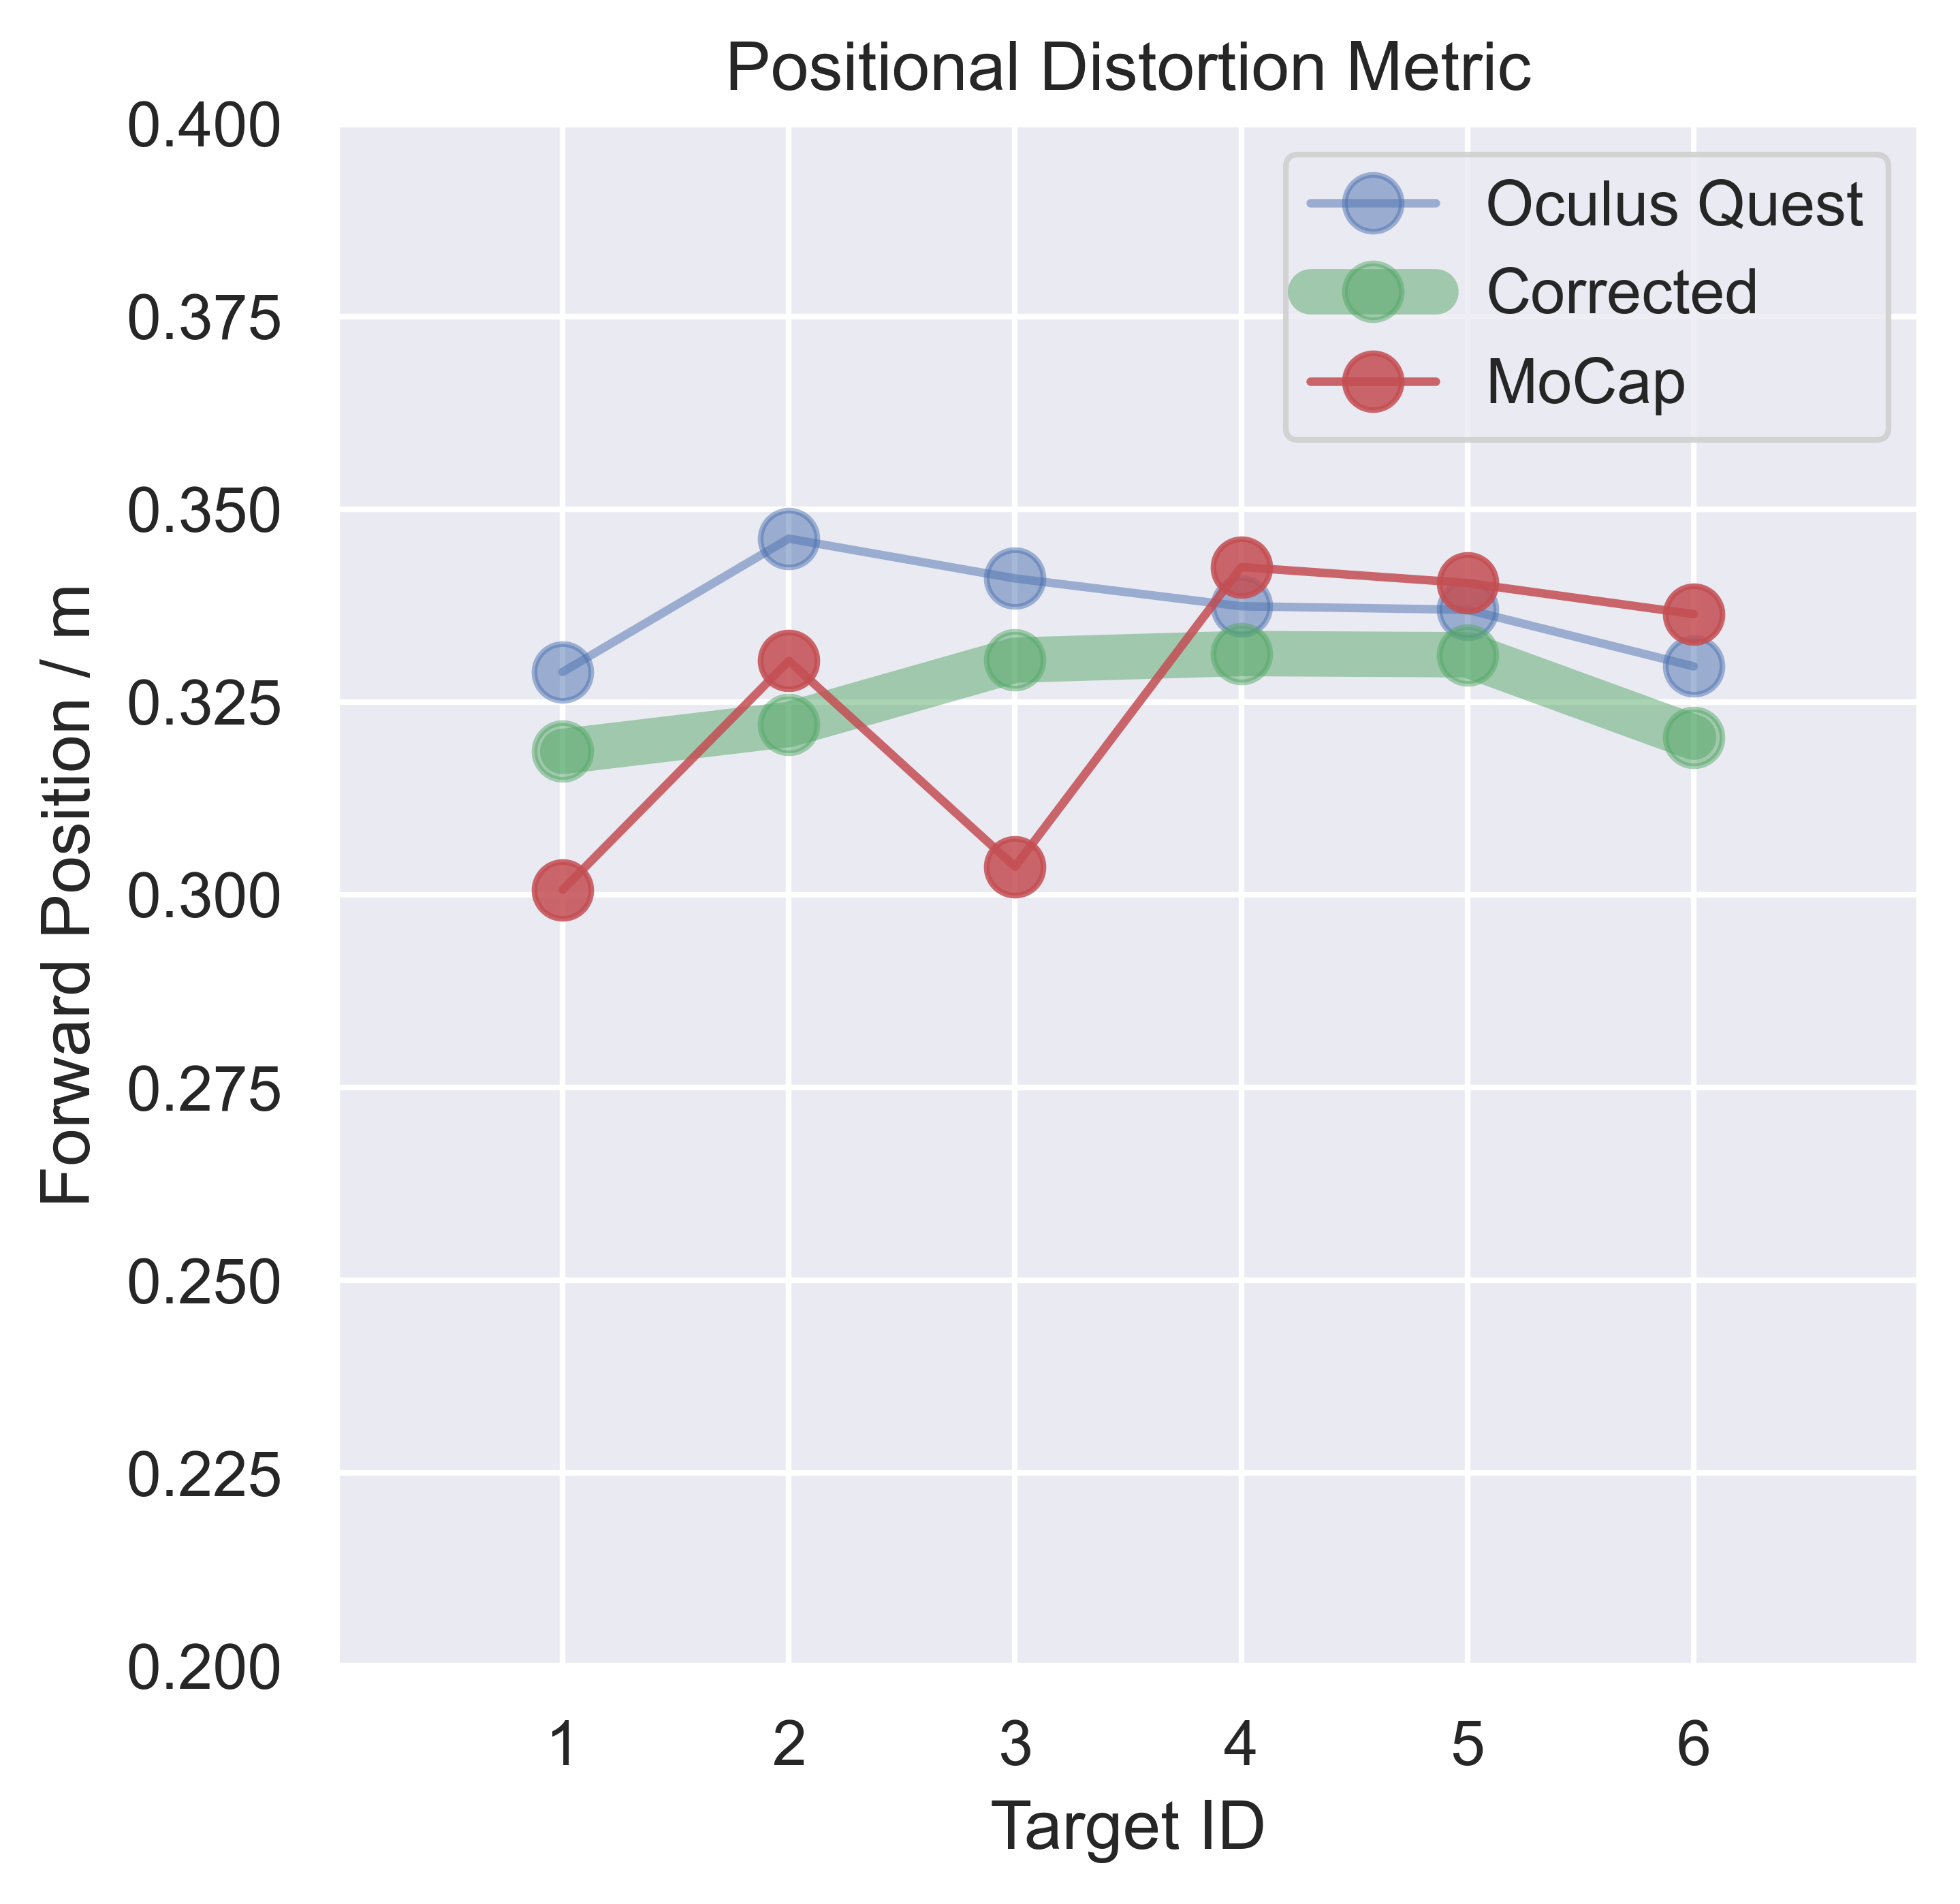
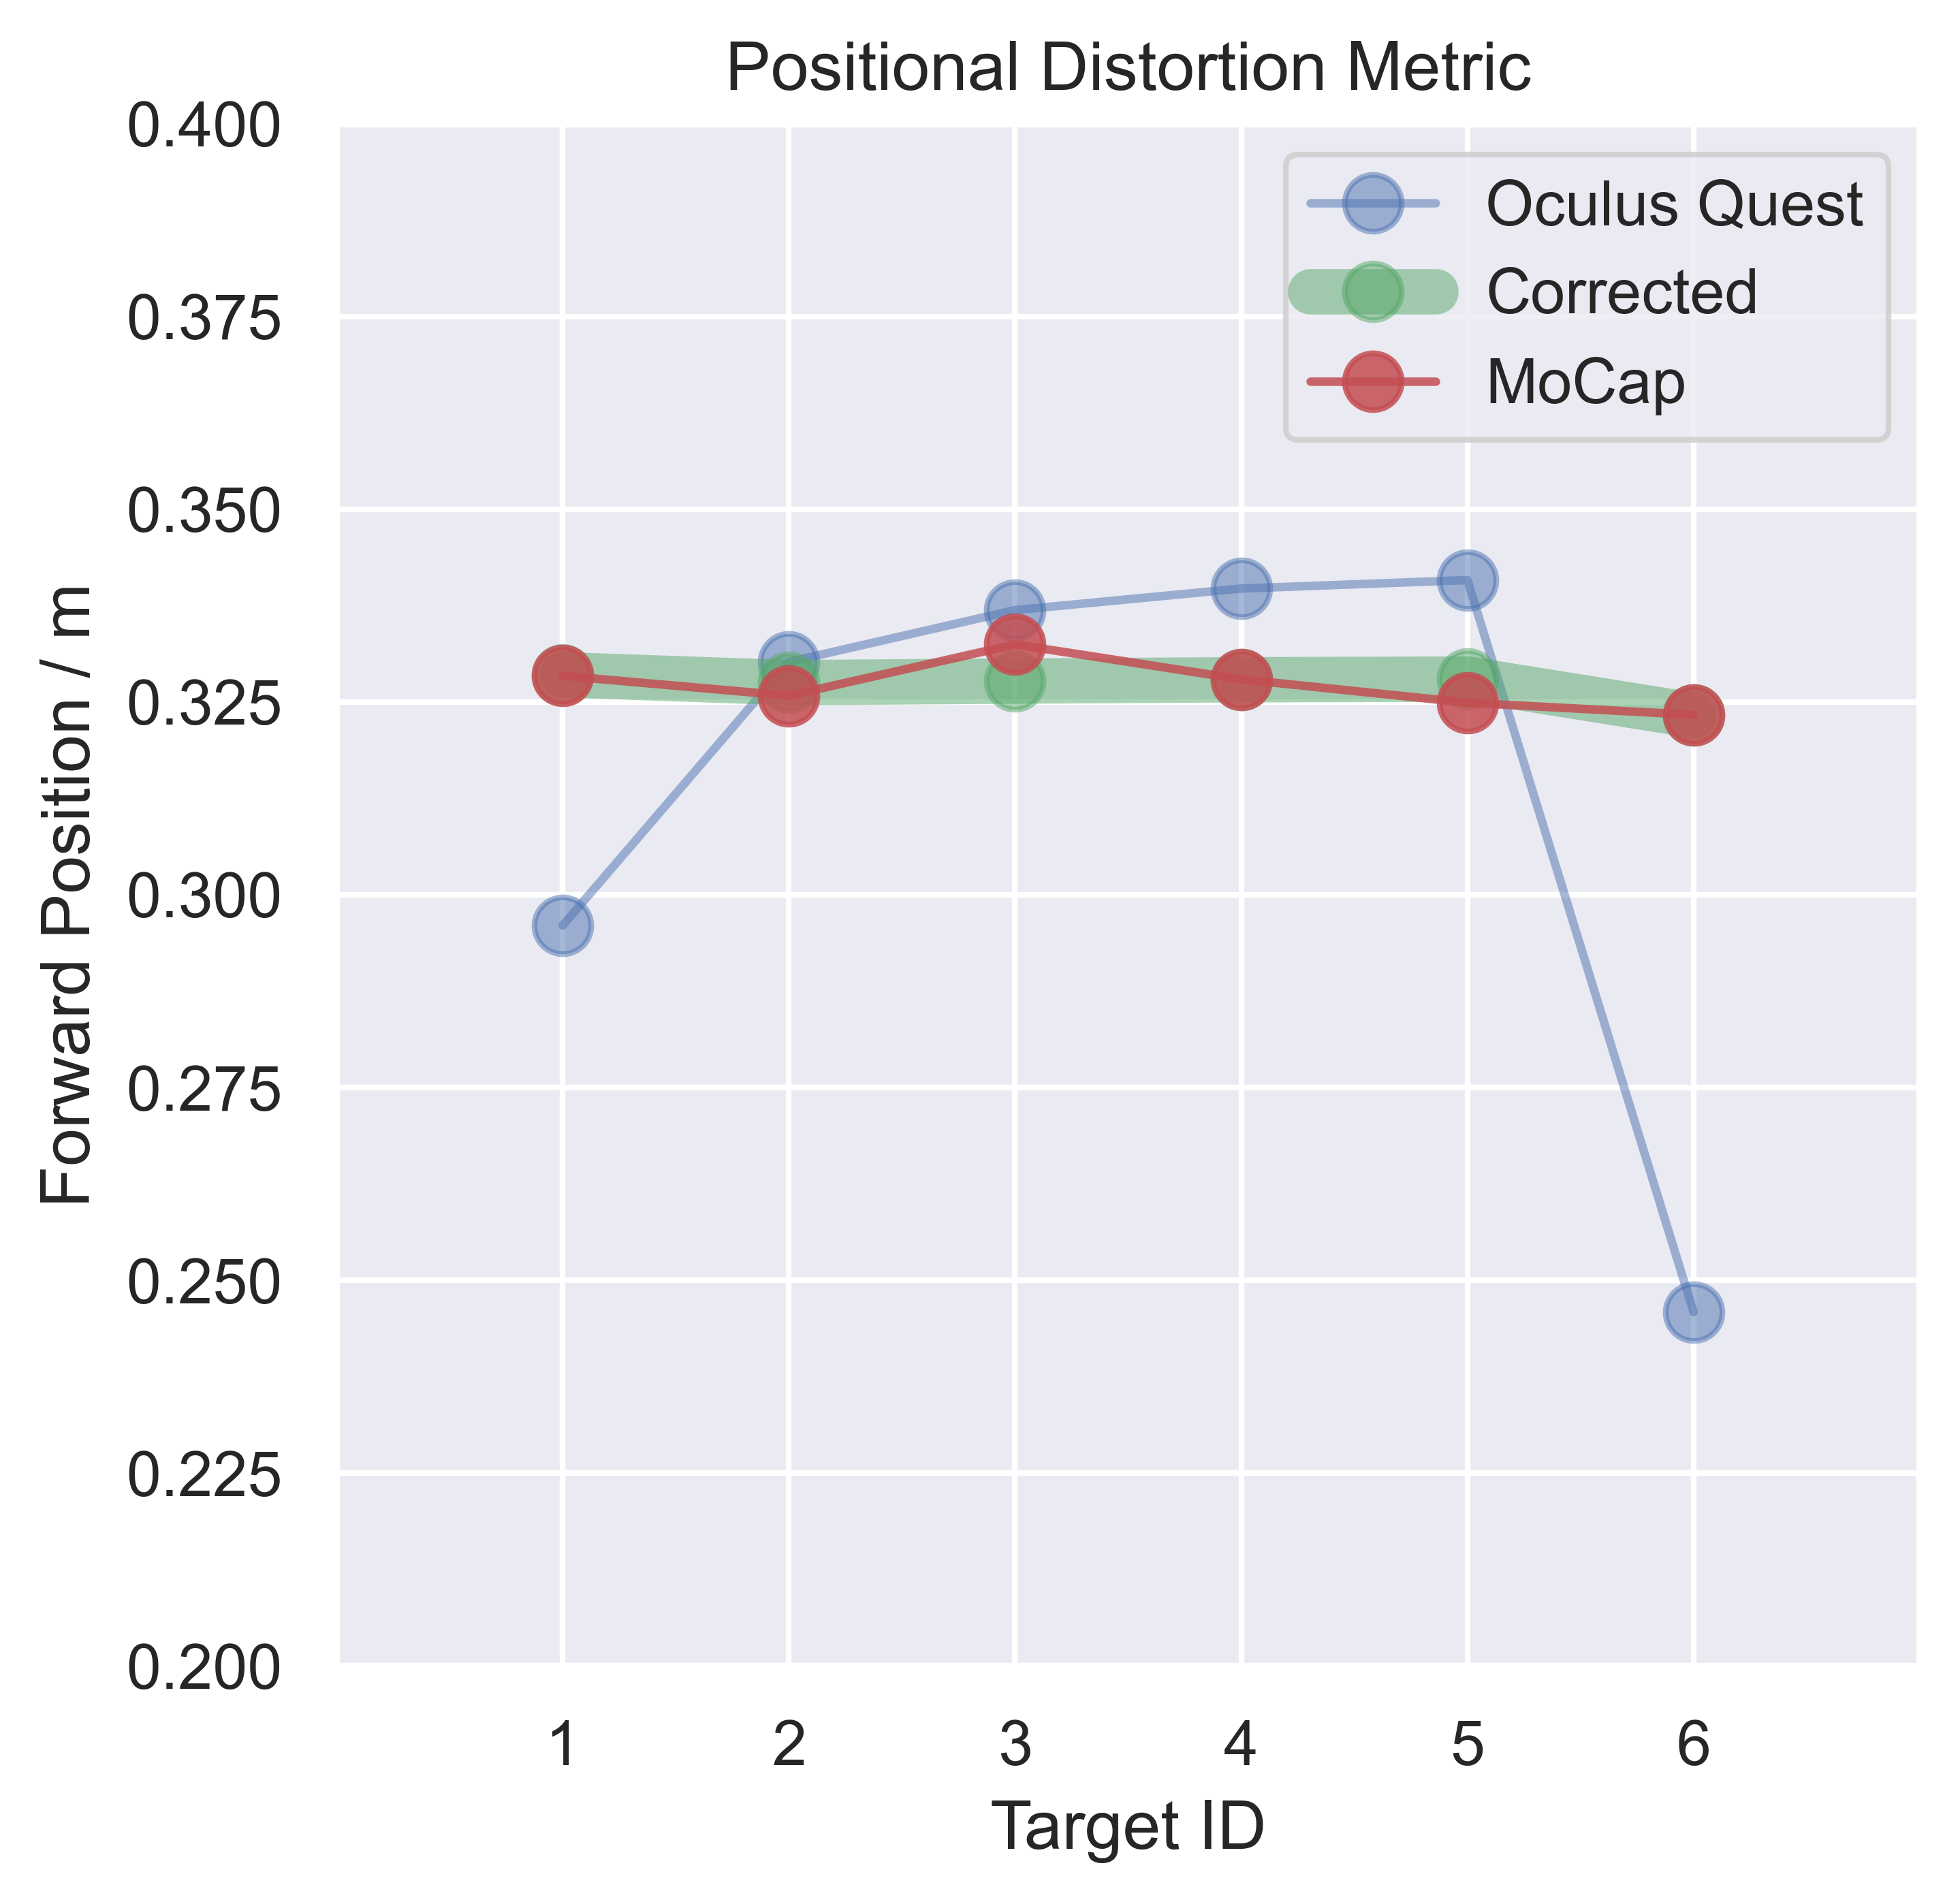
Distortion between virtual and
real positions provides a compact error metric
Distortion Coefficients
10, -52, 67
Distortion Coefficients
-141 839 -1252
Distortion Coefficients
11 -60 78

